Slide 1

Simple Drawing App
A Feature-Rich Digital Canvas Built with Python
Presented by:
Asutosh Sahu • Biswajit Sahu • Debasis Nayak
Himanshu Sahoo • Kunmun Sahu • Omm Prakash Mohanty

Slide 2
Acknowledgements
We express our deepest gratitude for the invaluable guidance, technical insights, and unwavering support provided throughout the development of this project.
"
— Mr. Saumya Ranjan Pradhan (Project Guide)
"

Slide 3
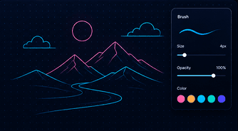
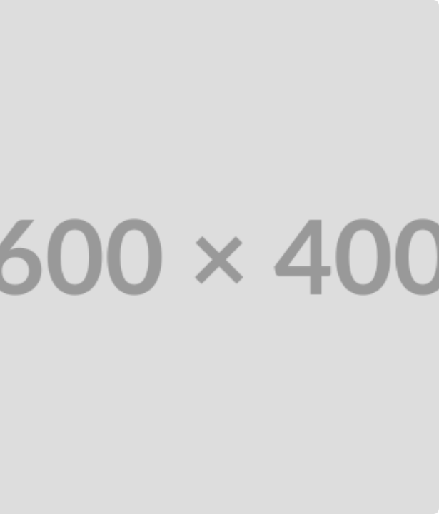
Project Overview
An easy-to-use desktop application made for creating digital drawings quickly and smoothly.
Create freehand drawings using simple and adjustable brush tools.
Draw basic shapes like lines, rectangles, and circles with ease.
Choose pen colors, change brush size, and set the canvas background color.
Save your finished drawings as high-quality PNG image files.

Slide 4




Objectives
Interactive Interface
Practical Learning
Learn Python, Tkinter GUI development, event handling, and graphics programming through a real project.
Simple and attractive GUI with an easy-to-use drawing workspace.
Smart Drawing Tools
User-Friendly Design
Includes freehand drawing, eraser, geometric shapes, color selection, adjustable brush size, and PNG image saving.
Simple controls and an intuitive layout make the application easy for beginners to use.

Slide 5

Process & Methodologies
1. Setup
2. Layout
3. Build
4. Events
5. Output
Import Python libraries
Design GUI via Tkinter
Implement core tools
Handle mouse input
Save PNG & Clear Canvas

Slide 6
System Specifications
Category | Requirement
Operating System | Windows 10 / 11
Programming Language | Python 3.x
Core Libraries | Tkinter (GUI standard), Pillow / PIL (Image handling)
Hardware CPU / RAM | Intel Core i3 (or equivalent) / 4 GB minimum
Display & Input | 1366 × 768 minimum resolution, Keyboard & Mouse

Slide 7








Application Logic Flow
Initialize
Interface
Interact
Execute
Launch the application and load the Tkinter GUI.
Create the canvas, toolbar, and drawing controls.
Choose a drawing tool, color, and brush size.
Draw using mouse events, then save or clear the canvas.

Slide 8
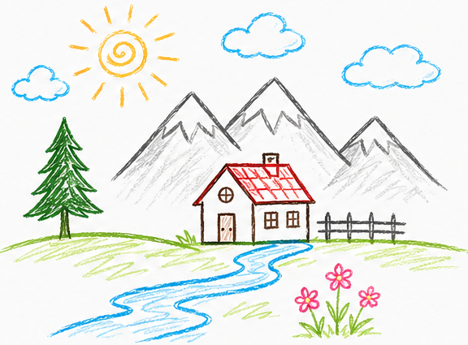
Project Outcomes
Successfully developed a fully functional desktop drawing application.
Implemented drawing tools including pencil, eraser, and geometric shapes.
Added customizable brush size, pen color, and canvas background color.
Enabled users to save drawings as high-quality PNG images.
Designed a simple and user-friendly interface for beginners and regular users.

Slide 9
Future Scope
History Control: Add Undo and Redo functionality.
Brush Engine: Support multiple brush styles and textures.
Fill Tool: Add a Paint Bucket tool for quick color filling.
Importing: Open and edit existing image files.
Typography: Add text and annotations to drawings.
Export Options: Support JPEG, BMP, and PDF formats.
Layering: Support multiple layers for advanced, non-destructive editing.
Navigation: Add canvas zoom and pan functionality.

Slide 10






Key References
Documentation
Literature
Online Learning
Official Python 3.x, Tkinter, and Pillow (PIL) documentation.
Books and guides on Python GUI programming and Tkinter development.
YouTube tutorials and online courses on Python GUI development.

Slide 11
Final Conclusion
The Simple Drawing App successfully demonstrates the use of Python and Tkinter to build an interactive desktop application. It provides essential drawing tools, real-time user interaction, and image-saving functionality through a simple and user-friendly interface. This project also serves as a strong foundation for adding more advanced features in the future.

Slide 12
Thank You!
We appreciate your time and attention.
The Simple Drawing App Project Team

